Slide 1
Internet Technology (1)
بسم الله الرحمن الرحيم
Lecture (6)

Slide 2
Lecture Agenda
E-mail Overview

Slide 3
E-mail Overview
Email is a service which allows us to send the message in electronic mode over the internet. It offers an efficient, inexpensive and real time mean of distributing information among people.
E-Mail Address:
Each user of email is assigned a unique name for his email account. This name is known as E-mail address. Different users can send and receive messages according to the e-mail address.
E-mail is generally of the form username@domainname. For example, webmaster@tutorialspoint.com is an e-mail address where webmaster is username and tutorialspoint.com is domain name.

Slide 4
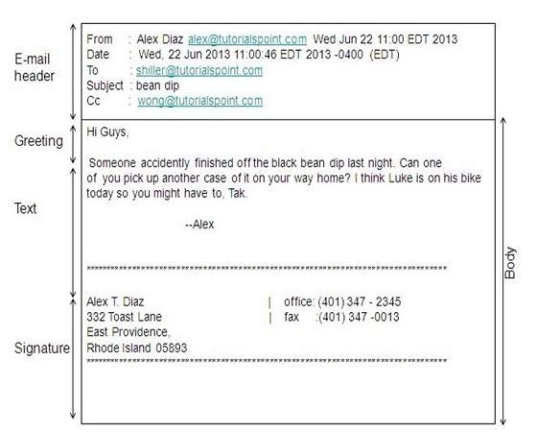
E-mail Message Components
E-mail message comprises of different components: E-mail Header
Greeting
Text
Signature.
These components are described in the following diagram:

Slide 5
E-mail Working
E-mail System:
E-mail system comprises of the following three components:
1.Mailer
2.Mail Server
3.Mailbox
Mailer:
It is also called mail program, mail application or mail client. It allows us to manage, read and compose e-mail.
Mail Server:
The function of mail server is to receive, store and deliver the email. It is must for mail servers to be Running all the time because if it crashes or is down, email can be lost.
Mailboxes:
Mailbox is generally a folder that contains emails and information about them.

Slide 6
Working of E-mail
Email working follows the client server approach. In this client is the mailer i.e. the mail application or mail program and server is a device that manages emails.
Following example will take you through the basic steps involved in sending and receiving emails and will give you a better understanding of working of email system:
Suppose person A wants to send an email message to person B.
Person A composes the messages using a mailer program i.e. mail client and then select Send option.
The message is routed to Simple Mail Transfer Protocol to person B’s mail server.
The mail server stores the email message on disk in an area designated for person B.

Slide 7
Working of E-mail
Now, suppose person B is running a POP client and knows how to communicate with B’s mail server.
It will periodically poll the POP server to check if any new email has arrived for B.As in this case, person A has sent an email for person B, so email is forwarded over the network to B’s PC. This is message is now stored on person B’s PC.
The following diagram gives pictorial representation of the steps discussed above:
Notes:
POP stands for Post Office Protocol. It is generally used to support a single client.
There are several versions of POP but the POP 3 is the current standard.
Key Points:
POP is an application layer internet standard protocol.
Since POP supports offline access to the messages, thus requires less internet usage time.
POP does not allow search facility .In order to access the messaged, it is necessary to download them.
It allows only one mailbox to be created on server.
It is not suitable for accessing non mail data.
POP commands are generally abbreviated into codes of three or four letters. Eg. STAT.

Slide 8
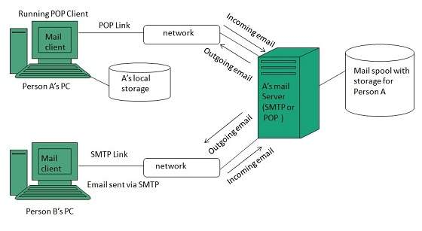

Slide 9
E-mail Features
Now a day, the mail client comes with enhanced features such as: attachment, address book.
Here in this section we will discuss all of these features which will give you a better understanding of added feature of a mail client program.

Slide 10
E-mail Features
1.Attachment:
Ability to attach file(s) along with the message is one of the most useful features of email. The attachment may be a word document, PowerPoint presentation, audio/video files, or images…..
In order to attach file(s) to an email, click the attach button. As a result, a dialog box appears asking for specifying the name and location of the file you want to attach.
Once you have selected the appropriate file, it is attached to the mail.
Usually a paper clip icon appears in the email which indicates that it has an attachment.
When adding an attachment it is better to compress the attached files so as to reduce the file size and save transmission time as sending and downloading large files consumes a lot of space and time.

Slide 11
E-mail Features
2.Address Book:
Address book feature of a mail program allows the users to store information about the people whom they communicate regularly by sending emails. Here are some of the key features of an Address book:
Address book includes the names, email addresses, phone number etc. of the people.
Using address book allows us not to memorize email of address of a person, you just have to select recipient name from the list.
When you select a particular name from the list, the corresponding email address link automatically get inserted in to the To: field.
Address book also allows creating a group so that you can send a email to very member of the group at once instead of giving each person email address one by one.

Slide 12
E-mail Security
E-mail Hacking:
Email hacking can be done in any of the following ways:
Spam
Virus
Phishing
1.Spam:
E-mail spamming is an act of sending Unsolicited Bulk E-mails (UBI) which one has not asked for. Email spams are the junk mails sent by commercial companies as an advertisement of their products and services.

Slide 13
E-mail Security
2.Virus:
Some emails may incorporate with files containing malicious script which when run on your computer may lead to destroy your important data.
3.Phishing:
Email phishing is an activity of sending emails to a user claiming to be a legitimate enterprise. Its main purpose is to steal sensitive information such as usernames, passwords, and credit card details.
Such emails contains link to websites that are infected with malware and direct the user to enter details at a fake website whose look and feels are same to legitimate one.

Slide 14
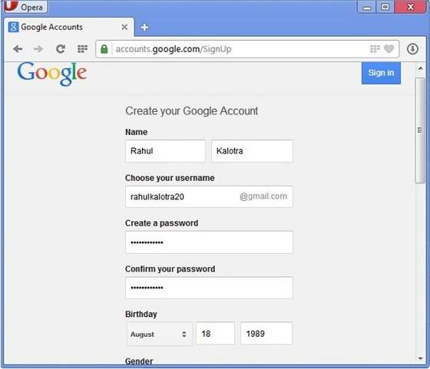
Email Operations
Creating Email Account:
There are various email service provider available such as Gmail, hotmail, ymail, rediff mail etc. Here we will learn how to create an account using Gmail.
Open gmail.com and click create an account.
Now a form will appear. Fill your details here and click Next Step.

Slide 15
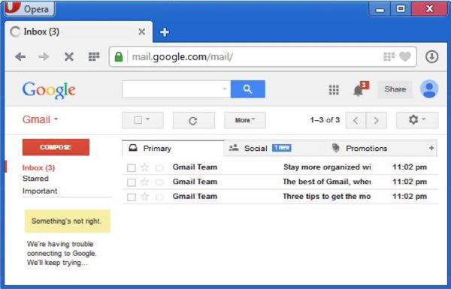
Email Operations
This step allows you to add your picture. If you don’t want to upload now, you can do it later. Click Next Step.
Now a welcome window appears. Click Continue to Gmail.
Wow!! You are done with creating your email account with Gmail. It’s that easy. Isn’t it?
Now you will see your Gmail account as shown in the following image:

Slide 16
Email Operations
Key Points:
Gmail manages the mail into three categories namely Primary, Social and Promotions.
Compose option is given at the right to compose an email message.
Inbox, Starred, Sent mail, Drafts options are available on the left pane which allows you to keep track of your emails.

Slide 17
Email Operations
1.Composing and Sending Email:
Before sending an email, we need to compose a message. When we are composing an email message, we specify the following things:
Sender’s address in To field
Cc (if required)
Bcc (if required)
Subject of email message
Text
Signature

Slide 18
Email Operations
2.Reading Email:
Every email program offers you an interface to access email messages. Like in Gmail, emails are stored under different tabs such as primary, social, and promotion. When you click one of tab, it displays a list of emails under that tab.
In order to read an email, you just have to click on that email. Once you click a particular email, it gets opened.
The opened email may have some file attached with it. The attachments are shown at the bottom of the opened email with an option called download attachment.

Slide 19
Email Operations
3.Forwarding Email:
It is also possible to send a copy of the message that you have received along with your own comments if you want. This can be done using forward button available in mail client software.
The difference between replying and forwarding an email is that when you reply a message to a person who has send the mail but while forwarding you can send it to anyone.
When you receive a forwarded message, the message is marked with a > character in front of each line and Subject: field is prefixed with Fw.

Slide 20
Email Operations
Deleting Email:
If you don’t want to keep email into your inbox, you can delete it by simply selecting the message from the message list and clicking delete or pressing the appropriate command.
Some mail clients offers the deleted mails to be stored in a folder called deleted items or trash from where you can recover a deleted email.

Slide 21
The end

Slide 22
Research in
OSI Model AND TCP/IP Model

